Slide 1
IOT BASED ACCURATE THERMAL SCREENING AND ALERT FOR COVID SITUATION USING BEAGLEBONE

Slide 2
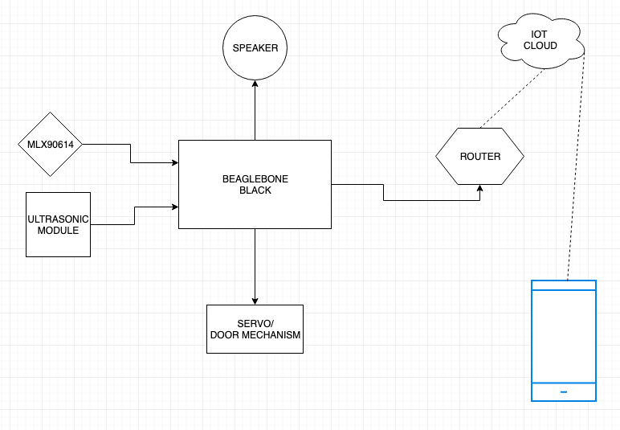
BLOCK DIAGRAM

Slide 3
MAIN FEATURES
Automated Contactless Temperature measurement
Automated Calibration based on the distance of the person.
High accuracy achieved.
Notification alert if abnormal temperature detected
Can be integrated with door, hence doors will only open if person is safe to go.

Slide 4
HARDWARE REQUIREMENTS
Beaglebone Black
MLX90614 Module
LASER MODULE
Speaker
Servo Motor
WifI Router
LAN Cable
LCD SCREEN
CONNECTING CABLES

Slide 5
BEAGLEBONE BLACK
The BeagleBoard is a low-power open-source single-board computer produced by Texas Instruments in association with Digi-Key and Newark element14.
The BeagleBoard was also designed with open source software development in mind, and as a way of demonstrating the Texas Instrument's OMAP3530 system-on-a-chip.

Slide 6
MLX90614
The MLX90614 is an infrared thermometer for non-contact temperature measurements.
Both the IR sensitive thermopile detector chip and the signal conditioning ASIC are integrated in the same TO-39 can.
Integrated into the MLX90614 are a low noise amplifier, 17-bit ADC and powerful DSP unit thus achieving high accuracy and resolution of the thermometer.

Slide 7
Laser Module
This 100mW laser module emits a small intense focused beam of visible red light.
The module can be used with an Beaglebone module to perform basic remote signalling or to point on something visibly.

Slide 8
SERVO MOTOR
The TowerPro SG90 9g Mini Servo is a 180° rotation servo.
It is a Digital Servo Motor that receives and processes PWM signal faster and better.
It equips sophisticated internal circuitry that provides good torque, holding power, and faster updates in response to external forces.

Slide 9
SPEAKER
A loudspeaker is an electroacoustic transducer; a device which converts an electrical audio signal into a corresponding sound.
. The sound source (e.g., a sound recording or a microphone) must be amplified or strengthened with an audio power amplifier before the signal is sent to the speaker.

Slide 10
LED SCREEN
OLED’s are the future of displays, as they possess some of the greatest advantages over both conventional display technologies of LCD’s and LED‘s.
The most attractive thing about using the OLED displays is that they do not need a back-light like conventional LCD/LED screens. The organic material itself has a property known as Electroluminescence (EL), which causes the material to “glow” when stimulated by a current or an electric field.

Slide 11
LAN CABLE
An Ethernet cable is the most common type of network cable used on a wired network whether at home or in any other business establishment.
This cable connects wired devices together to the local network for file sharing and Internet access.

Slide 12
INTERNET ROUTER
A router is a networking device that forwards data packets between computer networks. Routers perform the traffic directing functions on the Internet.
An example of a router would be the owner's cable or DSL router, which connects to the Internet through an Internet service provider (ISP).

